Slide 1
Improving Clinical Outcome Predictions Using Convolution over Medical Entities with Multimodal Learning
Presentation for Deep Learning for Healthcare
Prashanth Giriyappa Shankarappa, Sharad Kaushik

Slide 2
Introduction
For saving patient’s lives and managing hospital resources, early prediction of mortality and length of stay(LOS) is very important.
In this paper we are extracting patient triage data from high dimension clinical notes to improve clinical outcome prediction.
Model depicted in the paper uses Multimodal learning to predict tasks.
Convolution based multimodal architecture that learns from combining medical entities and time series ICU signals of Patients.
Different word embeddings such as Word2vec, FastText are used to compare model performance against other traditional machine learning models with multi-modal model outperforming others.

Slide 3
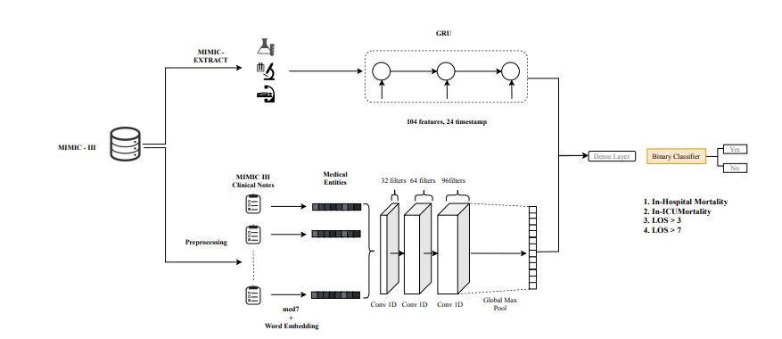
Multi-modal approach

Slide 4
Data and environment
In the paper we have used the Medical Information Mart for Intensive Care(MIMIC-III) database. We got access to the database through PhysioNet.
In the paper all experiments have been performed on google colab plus.

Slide 5
Model descriptions
• Word Embedding layer: Uses Word2Vec, FastText and concatenation of both to represent medical entities
• MIMIC Data: MIMIC Data extract is used to extract information from MIMIC-III database
• Clinical Named entity recognition(NER): Clinical NERs are extracted from Clinical Notes. 7 Named entities are considered - Drug, Strength, Duration, Route, Form, Dosage and Frequency.
• EHR Time series: Temporal information from EHR is extracted using GRU model. The GRU model uses as its input information that is extracted from MIMC-III Extract.
• Convolution layers and Max pooling: The model uses 3 stacked 1D convolution layers with filter size of 36, 64 and 96. The output of Convolution layer is passed through Global Max pooling layer.
• Fully Connected layer: Concatenation of output from Max pooling and GRU time series is fed into Fully connected layer.
• Binary Classifier: Binary classified is used to classify four predictive tasks- Mortality (In-Hospital Mortality, In-ICU Mortality) and LOS(>3 days and >7 days).

Slide 6
Experiments
Additional Prediction tasks - We will compare proposed model for additional prediction tasks like LOS >2, LOS >4 and LOS >5 with the best baseline model for all four clinical tasks, we will report both AUC, AUPRC and F1 scores.
Optimizer - Paper has used ADAM algorithm with a learning rate of 0.001. We will try other optimizers like Stochastic gradient descent or AdaGrad to see if it generalizes the model better.
Hyperparameter tuning - Proposed model is trained for 50 epochs, early stopping as 5, Kernel size as 3, Stride as 1 and using early stopping criteria as validation loss. We will perform three experiments by varying some of the hyperparameters – 100 epochs, early stopping at 10 instead of 5 and Dropout=0.5(from 0.2) – 100 epochs, Stride at 2, early stopping at 10 instead of 5 and Dropout at 0.5(from 0.2) – 100 epochs, Stride at 1, Kernel at 2, Early stopping at 10 instead of 5 and Dropout=0.5(from 0.2)

Slide 7
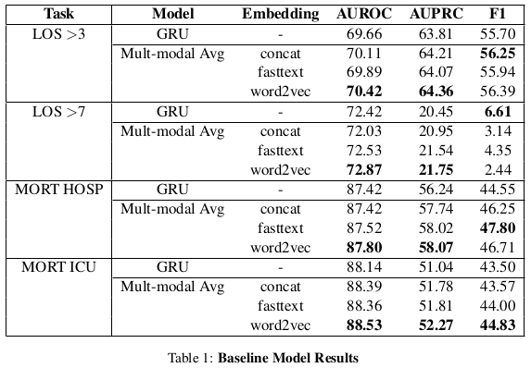
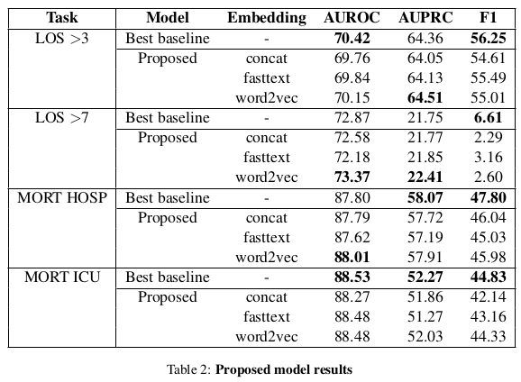
Results
Multimodal models- Avg and Proposed, both perform consistently better than Time Series for AUROC, AUPRC and F1 score
One anomaly was for LOS>7 where F1 score for Time series was better
Between Multimodal Avg and Proposed model, best performing model results were mixed

Slide 8
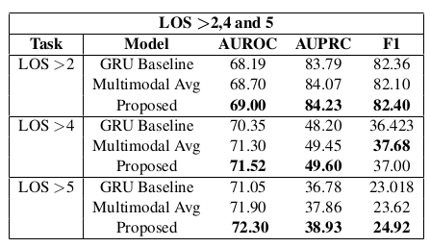
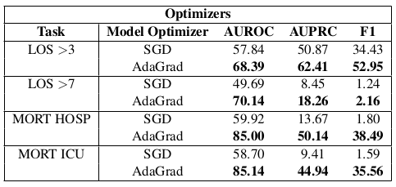
Results - Experiments
Length of stay > 2,4 and 5
We observed that ”proposed” model performed better for these prediction tasks.
Optimizers
Model that used AdaGrad optimizer performed better against SGD in all the four tasks and its performance was better by a large margin.
Both their performance was below ADAM optimizer’s performance.

Slide 9
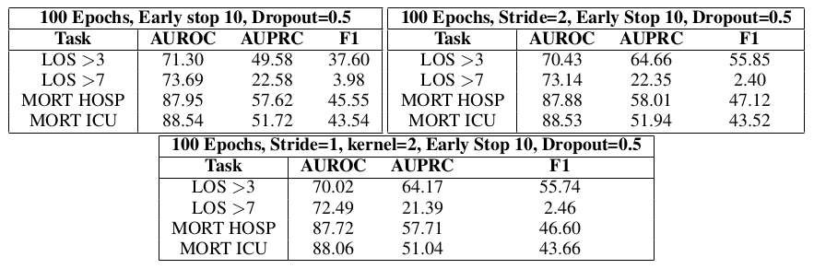
Results - Experiments
By changing hyperparameters we were able to get better results for some metrics by a small margin but they were not consistent for all metrics.

Slide 10
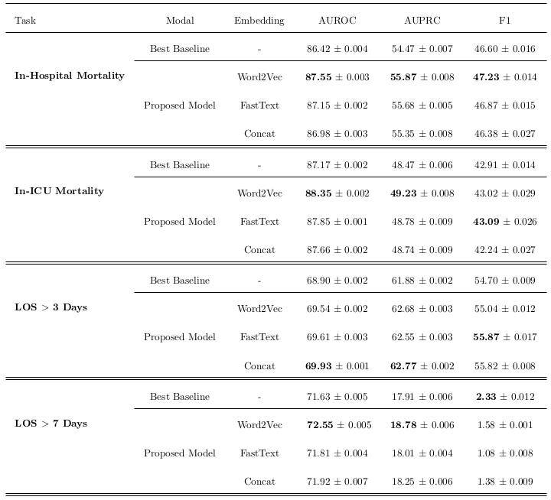
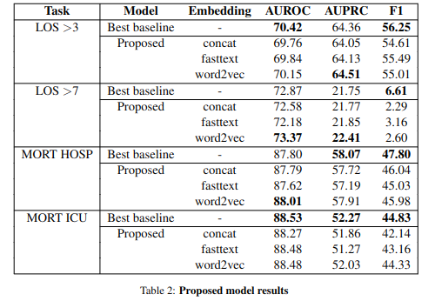
Comparison
Results from the paper
Our Recreation results

Slide 11
Discussion
We observed that the use of medical entity features improves prediction performance for most clinical prediction tasks.
Multimodal baseline and Proposed model both of which used NERs and combined clinical notes with timeseries data gave
better results for all the metrics.
Multimodal models increase all metrics performance which indicates the benefit of using medical entities for predicting mortality and LOS. They can also be considered better for modelling our experimental tasks for predicting LOS >2,LOS>4 and LOS>5.
An exception observed is for LOS >7 task where baseline timeseries model had a better F1 score.
There wasn’t significant performance differences between different embedding representations but Word2Vec performed slightly better in many instances when compared to FastText and Concatenated embeddings.
Proposed model did not always produce better score for prediction tasks in our recreation. Proposed model performed better than baseline model for Mortality Hospital task AUROC, for LOS>7 task AUROC and AUPRC and for LOS>3 task AUROC. For all other tasks and metrics, Baseline Multimodal model performed better.

Slide 12
Thank you

